Slide 1
CAPSTONE PROJECT
PLAY STORE APP REVIEW ANALYSIS
BY AKASH RAJ N

Slide 2
Points for Discussion
~ Data Summary
~Category Review Comparison
~ Category Install Comparison
~Content Rating
~Rating for each genre
~Apps in each category
~Translated Review in each Sentiment
~Size and Price relation
~Correlation heatmap analysis
~Possible pairplots
~Conclusion

Slide 3
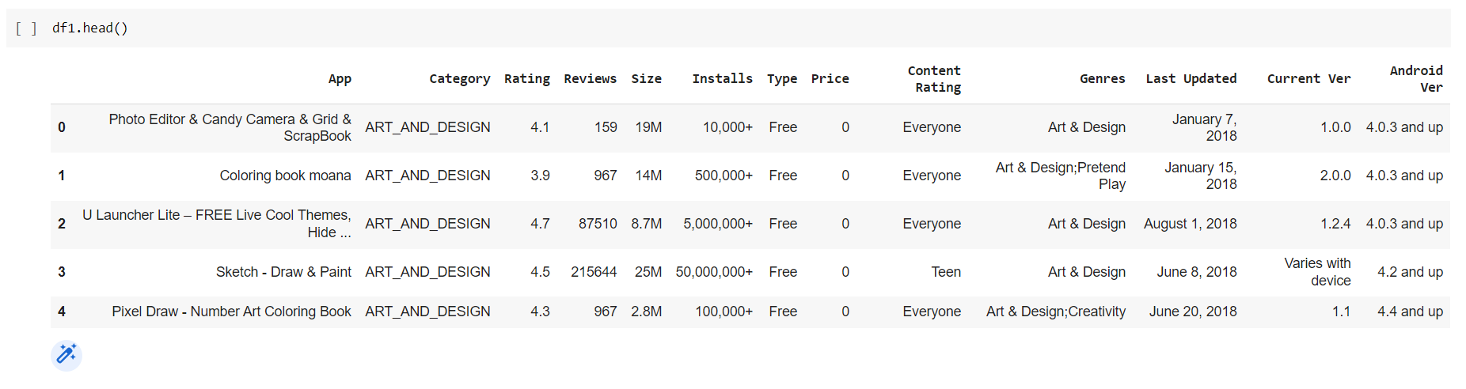
We have two dataframes with shape (10841,13) and (64295,5)
First dataframe - consists mostly of numerical data like price,installs,size and textual data like category,genres,Android version.

Slide 4
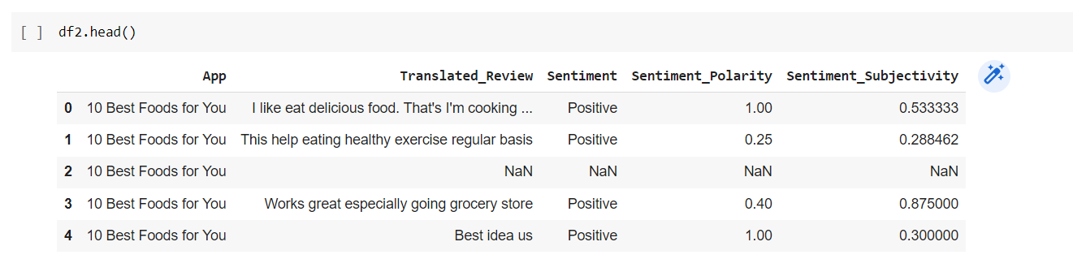
Second dataframe - Mainly regards with the user feedback information like reviews,sentiments.

Slide 5
Category Review Comparison
Review is the formal assessment with the intention of instituting change if necessary.
Reviews make the app more efficient.
From the graph in the next slide, we get that Social and Communication category are reviewed more while Medical and Events are reviewed less.

Slide 6
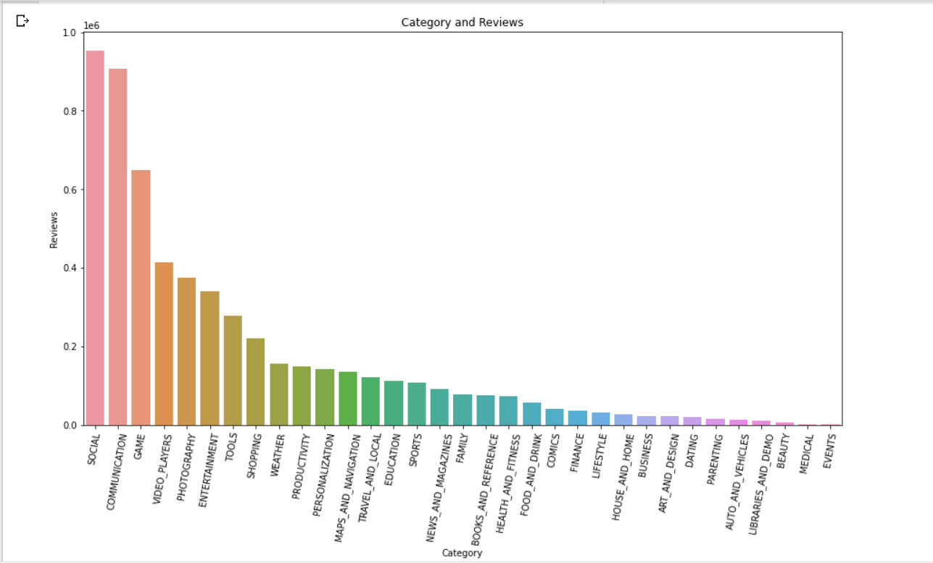

Slide 7
Category Install Comparison
Downloading of apps is the only way of earning for the app developers.
So they have to ensure that app released should make an impact among users and get a high count of downloads.
From graph, Communication category has the highest number of downloads while Medical and Events are having least downloads.

Slide 8
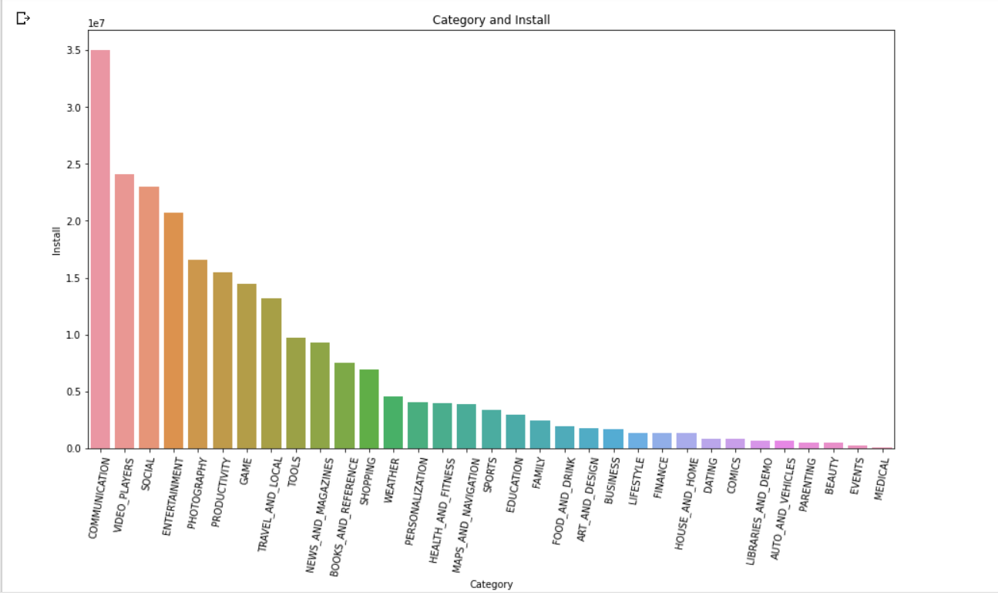

Slide 9
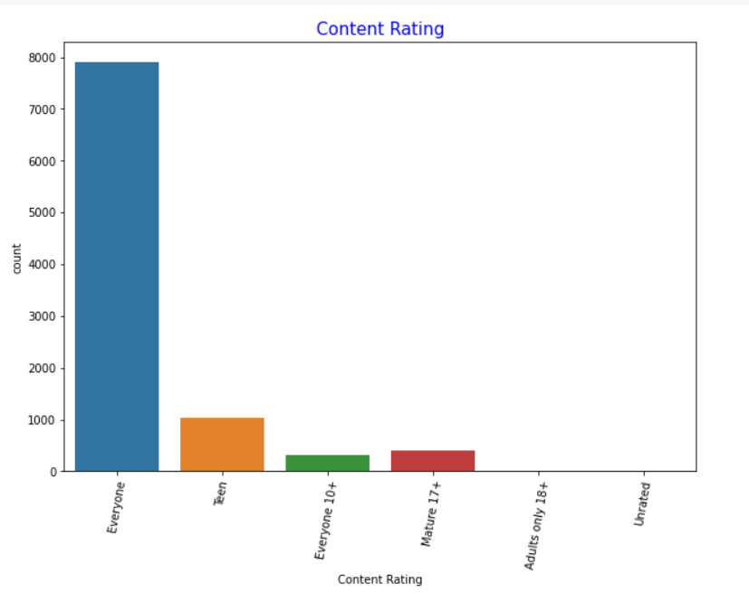
Content Rating
Content rating is essential for every app as some apps will be prevented from the usage of kids.Some games and dating apps will be some of the examples because of its matured content.
From graph,apps that can be used by everyone are more.
Adults only and unrated apps are released least.

Slide 10
Rating for each Genre
The mean rating for each genre is compared
Comics and Creativity , Board and brain games are two genres that has high mean rating.
Parenting and brain game genre has the lowest rating.
The graph has 4 non joining points.It shows the presence of null values

Slide 11
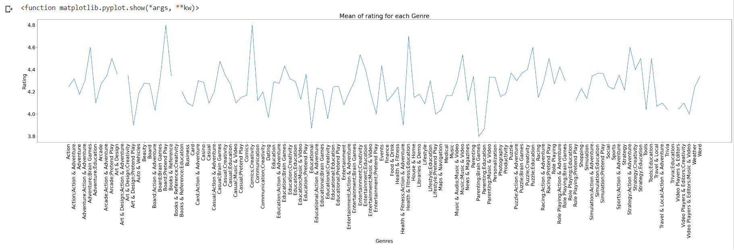

Slide 12
Number of apps in each Category
The apps developed will be more in the category which is common to all age and gender classifications.
Dating apps will be used by matured people.
Beauty apps will be more used by females.
From graph Beauty,Comics and Parenting has the minimum number of apps while Family has the most number of apps.

Slide 13
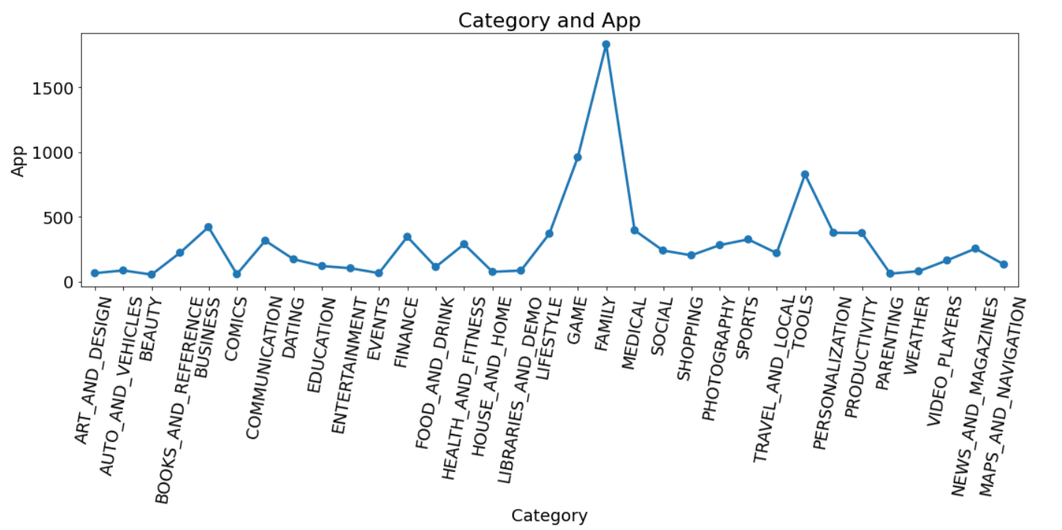

Slide 14
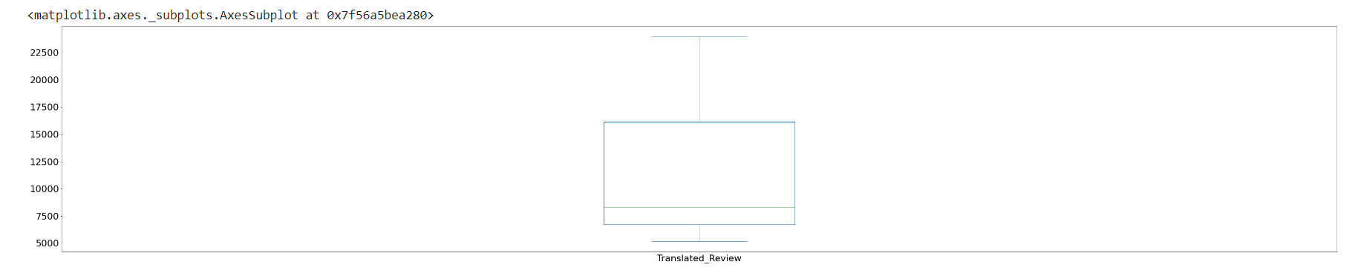
Translated Review for each sentiment
Positive,Negative and Neutral are the different sentiments.
From the boxplot, we can see that the minimum value is the neutral sentiment.
The maximum value is the positive sentiment while middle line is the negative sentiment

Slide 15
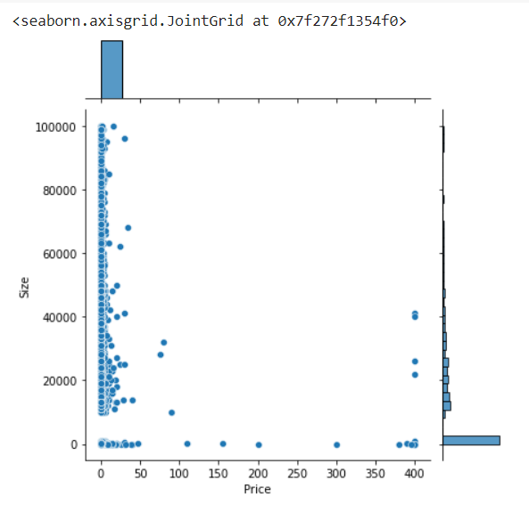
Size and Price
Jointplot consist of 3 plots where outer bars represent the distribution of independent variables x and y.Inside is a bivariate graph which shows the how y varies with x.
Size and price are not proportional to each other.
From graph ,the paid apps have comparatively low size.
Apps that have high size are free.

Slide 16
Correlation heatmap analysis
Correlation is used to find the pairwise correlation of all columns in the Pandas Dataframe.
The value of most positively correlated value is 1 while most negatively correlated value is -1.
From heatmap, we see that reviews and installs are positively correlated which is denoted in orange squares.
Price is negatively correlated with all the columns thus having negative values.

Slide 17
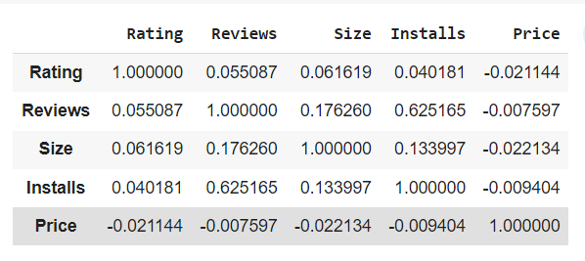
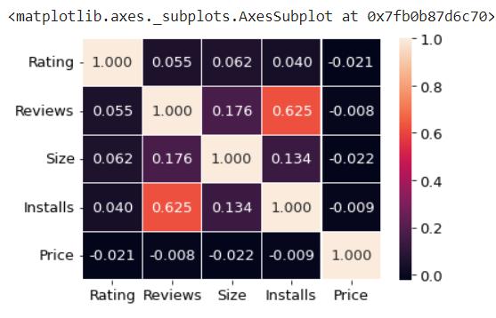

Slide 18
Possible pairplots
Pairplot is used to plot multiple bivariate distributions in a dataset.
The diagonal plots are the univariate plots.They will be histograms.
Pair plot is used to understand the best set of features to explain a relationship between two variables.
This also helps to form some classification models by drawing simple lines or making linear separations in our data set.

Slide 19
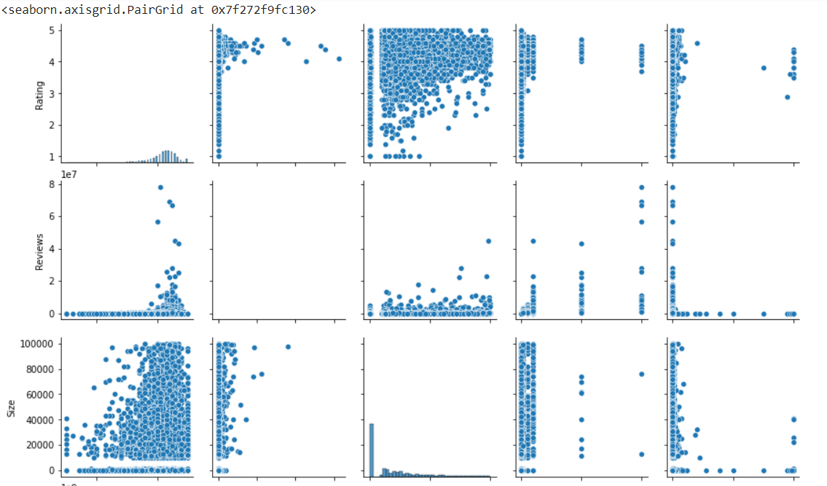

Slide 20
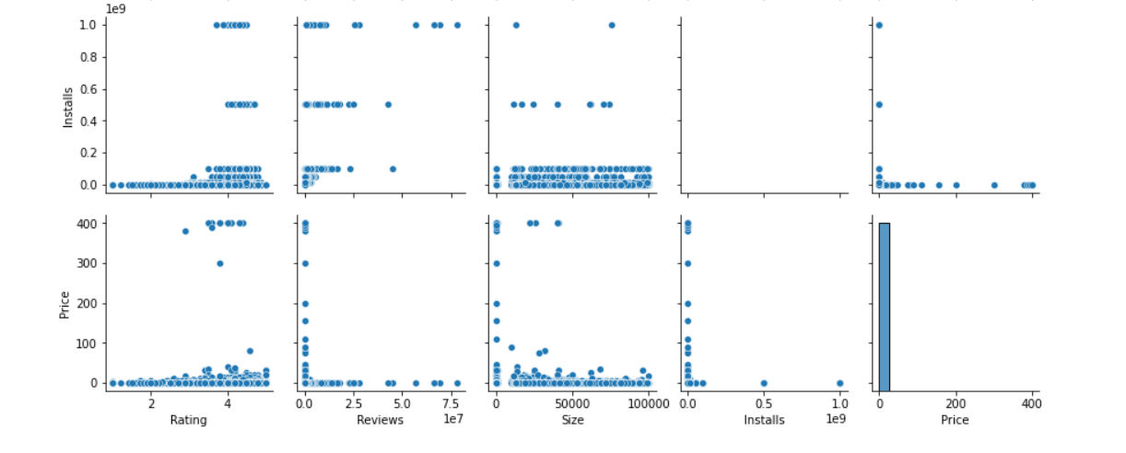

Slide 21
Conclusion
The categories that have high reviews are Social and Communication
That categories that have high installs are Communication and video player.
But as video players have no much reviews ,users can’t select the best video player app.
Beauty,Medical and Events apps are low in number of reviews and installs.So developing a more user friendly and added features in these apps may increase the number of installs thus increasing the reviews.
Apps used by everyone is more.Age restricted apps will be used by people in that age category thus reducing the installation of those apps.
Comics and creativity,Board and brain games has the highest rating while parenting has the lowest rating.So improving the parenting apps features can result in more downloads .

Slide 22
Family has the most number of apps while beauty,comics and parenting have low number of apps.Developing more apps in beauty,comics and parenting will suggest the users to installs and rate the new apps.
High sized apps are free.Paid apps doesn’t have much size as compared to free apps .
Thank you!!

